Slide 1

Uncertainty and Healthcare decision making: A dangerous combination?
22nd October 2020
Howard Thom
Lecturer in Health Economics, University of Bristol
Director, Clifton Insight

Slide 2
Disclaimer
The views presented are my own and I received no specific funding for the research presented.
I have received personal consulting fees from Roche Holding AG, Pfizer Inc, Novartis Pharma AG, and Janssen Pharmaceutica

Slide 3
Perspectives
Howard Thom, PhD.
University of Bristol. Clifton Insight.
Sabine Grimm, PhD.
Maastricht University Medical Centre+
Decision makers’ perspective, use of value of information
Stephane Regnier, PhD.
Novartis Pharma AG
Value of ‘cure’, time horizon uncertainties
Jeroen Jansen, PhD.
University of California San Francisco. PrecisionHEOR
Individual variation in outcomes and appetite for risk

Slide 4
My common issues with NICE and general HTA
Effectiveness discussion revolves around point estimates and ‘significance’ – despite American Statistical Association 2016 statement on p-values
Cost-effectiveness revolves around point estimates (typically the ICER) and disregards credible intervals or uncertainty
Purely deterministic results are often used
Particularly for sensitivity analyses
These are questionable if model is non-linear (e.g. Markov) or if parameters are correlated
Value of information (i.e. the payer uncertainty burden) is almost never considered
Sabine to discuss further
American Statistical Association. AMERICAN STATISTICAL ASSOCIATION RELEASES STATEMENT ON STATISTICAL SIGNIFICANCE AND P-VALUES. Provides Principles to Improve the Conduct and Interpretation of Quantitative Science March 7, 2016 2016.

Slide 5
What does the NICE methods guide say?
Guide to the methods of technology appraisal 2013
Section 5.8 is on “Exploring Uncertainty”
“A third source of uncertainty arises from parameter precision, once the most appropriate sources of information have been identified (that is, the uncertainty around the mean health and cost inputs in the model). Distributions should be assigned to characterise the uncertainty associated with the (precision of) mean parameter values. Probabilistic sensitivity analysis is preferred. This enables the uncertainty associated with parameters to be simultaneously reflected in the results of the model. In non-linear decision models, probabilistic methods provide the best estimates of mean costs and outcomes. The mean value, distribution around the mean, and the source and rationale for the supporting evidence should be clearly described for each parameter included in the model.”
Recommending but not mandating PSA (and ‘preferring’ it in Section 5.8.7) leads to many one-way sensitivity analyses using only deterministic analysis.
Section 5.8.11 still presents univariate best/worst case sensitivity as an important way of identifying key parameters, despite the existence of better methods such as VoI
These recommendations are not always adhered to in technology appraisals.

Slide 6
Simulation study using simple Markov model
Otherwise healthy
Adverse event
Dead
Two treatments
One has lower mortality but higher adverse events and higher price
6 month cycle length
5 year time horizon (i.e. 10 cycles)
Utilities and costs were pre-specified
Explored 10,000 possible probabilities and log odds ratios for anomalous results

Slide 7
Scenario 1 parameters
Parameter | Distribution
Probability adverse event treatment 1 | Gamma(6, 100), mean = 0.06
Probability death treatment 1 | Gamma(8.5, 100), mean = 0.085
Log odds ratio AE treatment 2 | Normal(0.16, sd=0.2)
Log odds ratio death treatment 2 | Normal(-0.30, sd=0.2)
Utility healthy | Normal(0.8, sd=0.05)
Utility AE | Normal(0.6, sd=0.1)
Cost healthy | Normal(1000, sd=100)
Cost AE | Normal(2000, sd=250)
Cost treatment 1 | Normal(9000, sd=100)
Cost treatment 2 | Normal(10000, sd=500)

Slide 8
Scenario 1 results
 | Mean (95% CrI)
Incremental costs deterministic | £9644
Incremental effects deterministic | 0.07
ICER deterministic | £147150
Incremental costs probabilistic | £1390 (127, 2804)
Incremental effects probabilistic | 0.08 (-0.21, 0.39)
Incremental net benefit probabilistic | £206 (-4814, 5728)
ICER probabilistic | £17421
CEAC | 0.52
You would have completely wrong decision (reject treatment 2) if you used the deterministic results
Note high uncertainty indicated by CEAC and incremental net benefit

Slide 9
Scenario 2 parameters
Parameter | Distribution
Probability adverse event treatment 1 | Gamma(12.7, 100), mean = 0.127
Probability death treatment 1 | Gamma(6, 100), mean = 0.06
Log odds ratio AE treatment 2 | Normal(0.22, sd=0.2)
Log odds ratio death treatment 2 | Normal(-0.72, sd=0.2)
Utility healthy | Normal(0.8, sd=0.05)
Utility AE | Normal(0.6, sd=0.1)
Cost healthy | Normal(1000, sd=100)
Cost AE | Normal(2000, sd=250)
Cost treatment 1 | Normal(9000, sd=100)
Cost treatment 2 | Normal(10000, sd=500)
Slightly changed the first four parameters

Slide 10
Scenario 2 results
 | Mean (95% CrI)
Incremental costs deterministic | £10403
Incremental effects deterministic | 0.33
ICER deterministic | £31134
Incremental costs probabilistic | £2133 (926, 3523)
Incremental effects probabilistic | 0.325 (0.11, 0.63)
Incremental net benefit probabilistic | £4358 (398, 9646)
ICER probabilistic | £6572
CEAC | 0.98
Here you would just about reject treatment 2 if using deterministic, even though the probabilistic (correct) results are unequivocal

Slide 11
Scenario 2 results
 | Mean (95% CrI)
Incremental costs deterministic | £10403
Incremental effects deterministic | 0.33
ICER deterministic | £31134
Incremental costs probabilistic | £2133 (926, 3523)
Incremental effects probabilistic | 0.325 (0.11, 0.63)
Incremental net benefit probabilistic | £4358 (398, 9646)
ICER probabilistic | £6572
CEAC | 0.98
And correlation, if doing one-by-one sensitivities, is a problem on top of this!
Here you would just about reject treatment 2 if using deterministic, even though the probabilistic (correct) results are unequivocal

Slide 12
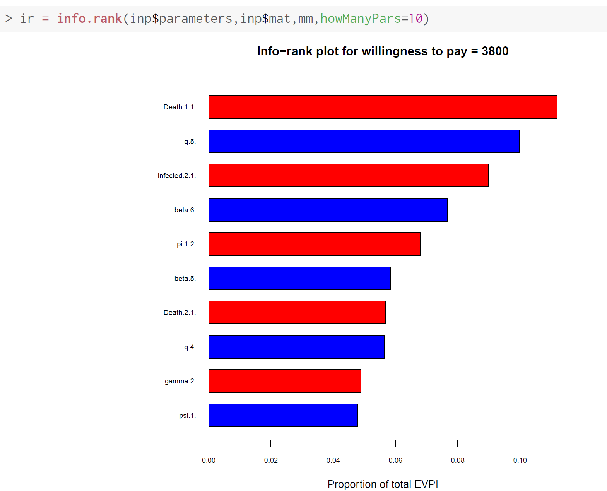
What does this analysis show us?
For non-linear models, never do deterministic analysis
If computation is the problem, use R or C++, not Excel.
To do threshold analysis, use recent method of Pieters 2020
Works for non-linear models and correlated parameters
To look at parameters one-by-one, do PSA and calculate EVPPI.
Implemented in R through BCEA
Pieters Z, Strong M, Pitzer VE, Beutels P, Bilcke J. A Computationally Efficient Method for Probabilistic Parameter Threshold Analysis for Health Economic Evaluations. Med Decis Making. 2020; 40(5):669-79.
Baio G, Berardi A, Heath A. Bayesian Cost-Effectiveness Analysis with the R package BCEA: Springer International Publishing; 2017.

